Slide 1
Introduction to OpenCV

Slide 2
Computer vision is a cutting edge field of computer science
that aims to enable computers to understand
what is being seen in an image.

Slide 3
Why it is so hard?
Camera and lens limitation
View point variation
Scaling
Clutter
Illusions

Slide 4
Applications
Self-driving cars
Face recognition
Snapchat
Number plate reading
Cricket ball tracking

Slide 5
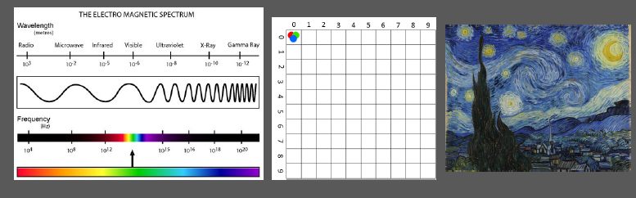
What is an image?
2 Dimensional representation of visible light spectrum.

Slide 6
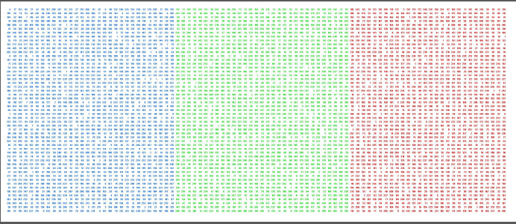
How computer store images
Lets play with dimension
By default it stores images as RGB colour space.

Slide 7
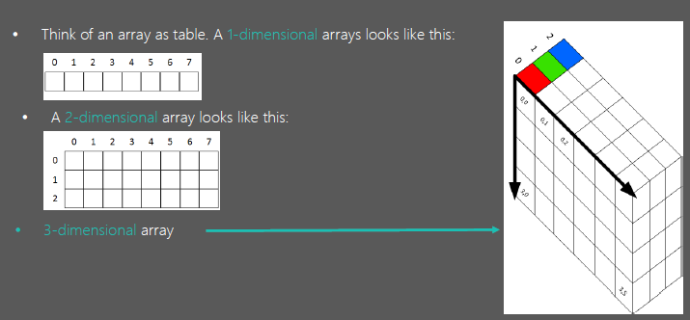

Slide 8
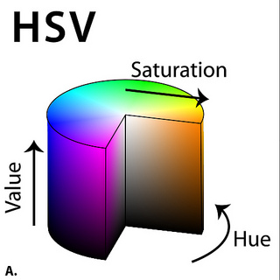
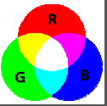

Colour spaces
There are different types of colour spaces. RGB, HSV, CMYK.
Hue – Colour Value (0 – 179)
Saturation – Vibrancy of colour (0-255)
Value – Brightness or intensity (0-255)

Slide 9
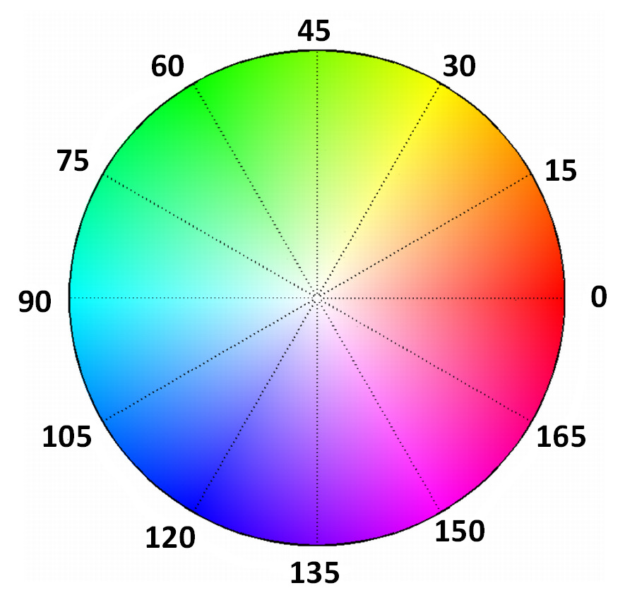
Colour filter
Colour Range Filters:
Red – 165 to 15
Green – 45 to 75
Blue – 90 to 120

Slide 10
Image manipulation
1. Transformations, affine and non affine
2. Translations
3. Rotations
4. Scaling, re-sizing and interpolations
5. Image Pyramids
6. Cropping
7. Arithmetic Operations
8. Bitwise Operations and Masking
9. Convolutions & Blurring
10. Sharpening
11. Thresholding and Binarization
12. Dilation, erosion, opening and closing
13. Edge Detection & Image Gradients
14. Perspective & Affine Transforms

Slide 11
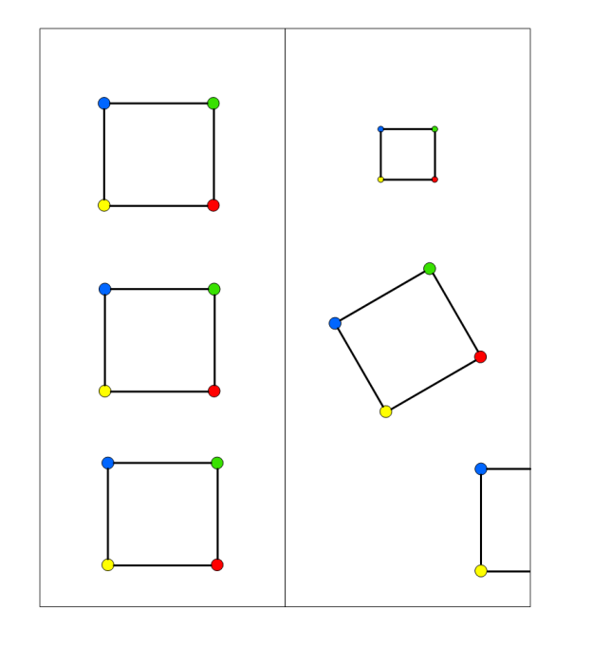
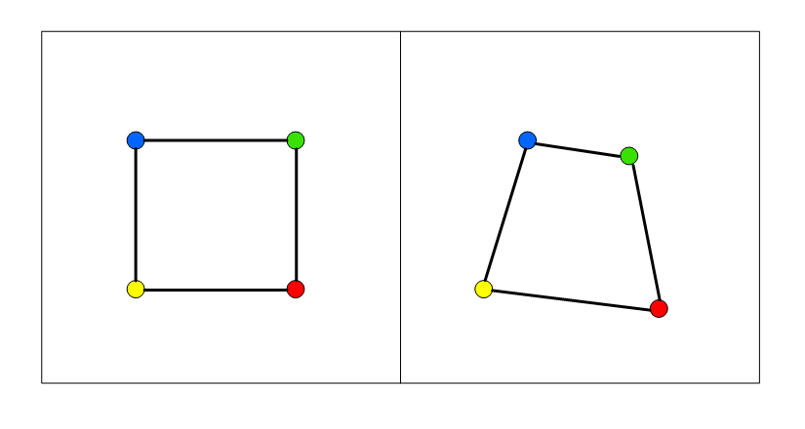
Affine vs non-affine transform
Scaling
Rotation
Translation
The non-affine or projective transformation does
not preserve parallelism, length, and angle. It does
however preserve collinearity and incidence.

Slide 12
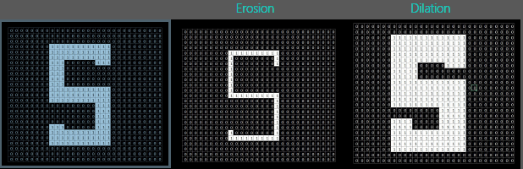
Dilation and Erosion
These are operations in the field of mathematical morphology:
Dilation – Adds pixels to the boundaries of objects in an image
Erosion – Removes pixels at the boundaries of objects in an image
Opening - Erosion followed by dilation
Closing - Dilation followed by erosion

Slide 13
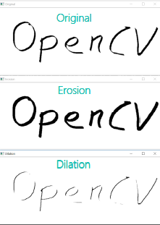

Slide 14
Edge Detection Algorithms
There are three main types of Edge Detection:
Sobel – to emphasize vertical or horizontal edges
Laplacian – Gets all orientations
Canny – Optimal due to low error rate, well defined edges and accurate detection.

Slide 15
